Slide 1
Reconstruction of charge number of heavy cosmic rays using Cherenkov Light
Robert Stein, Attila Abramowski, Dieter Horns
Universität Hamburg
DPG-Frühjahrstagung 2016

Slide 2
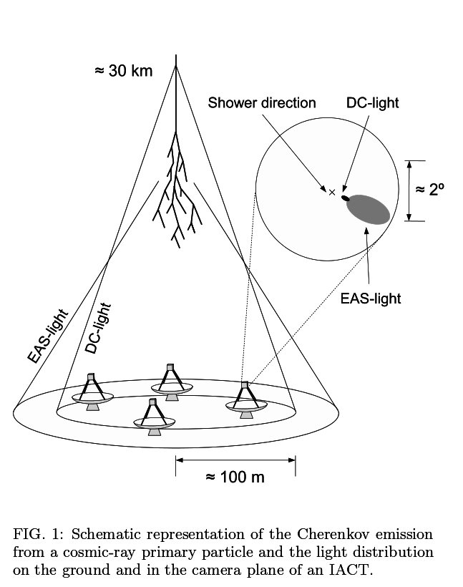
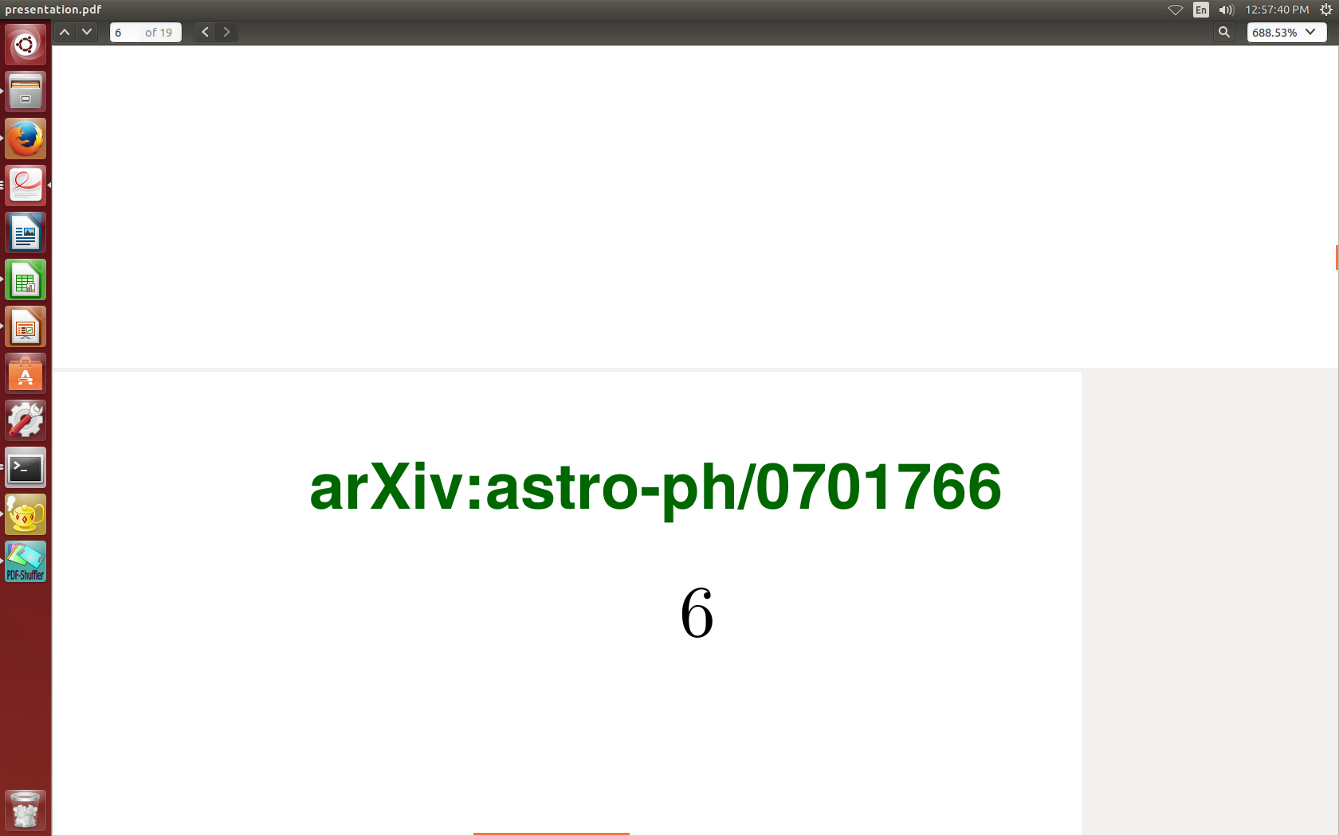
Aim of the analysis
Cosmic Rays Cherenkov Light is imaged by telescopes eg. HESS
Events currently reconstructed with Hillas Analysis
However Core position/Charge resolution is poor

Slide 3
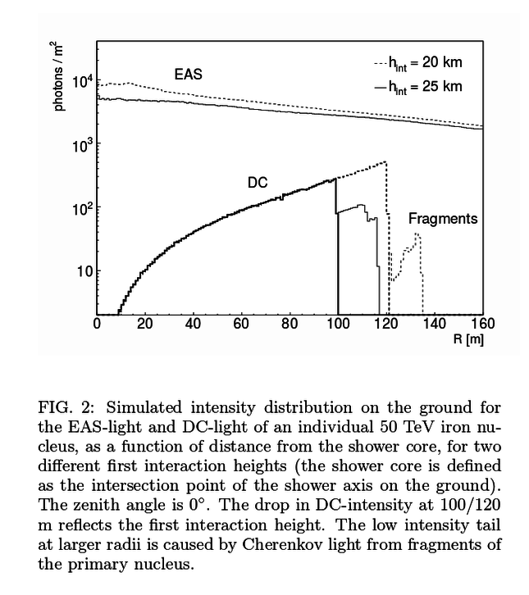
Lateral Photon Distribution Method
New reconstruction method, fitting received DC photons to known Lateral Distribution Function.
Aim is to improve reconstruction of Charge.

Slide 4
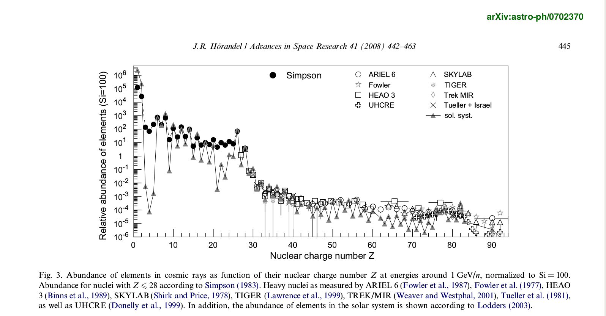

Slide 5
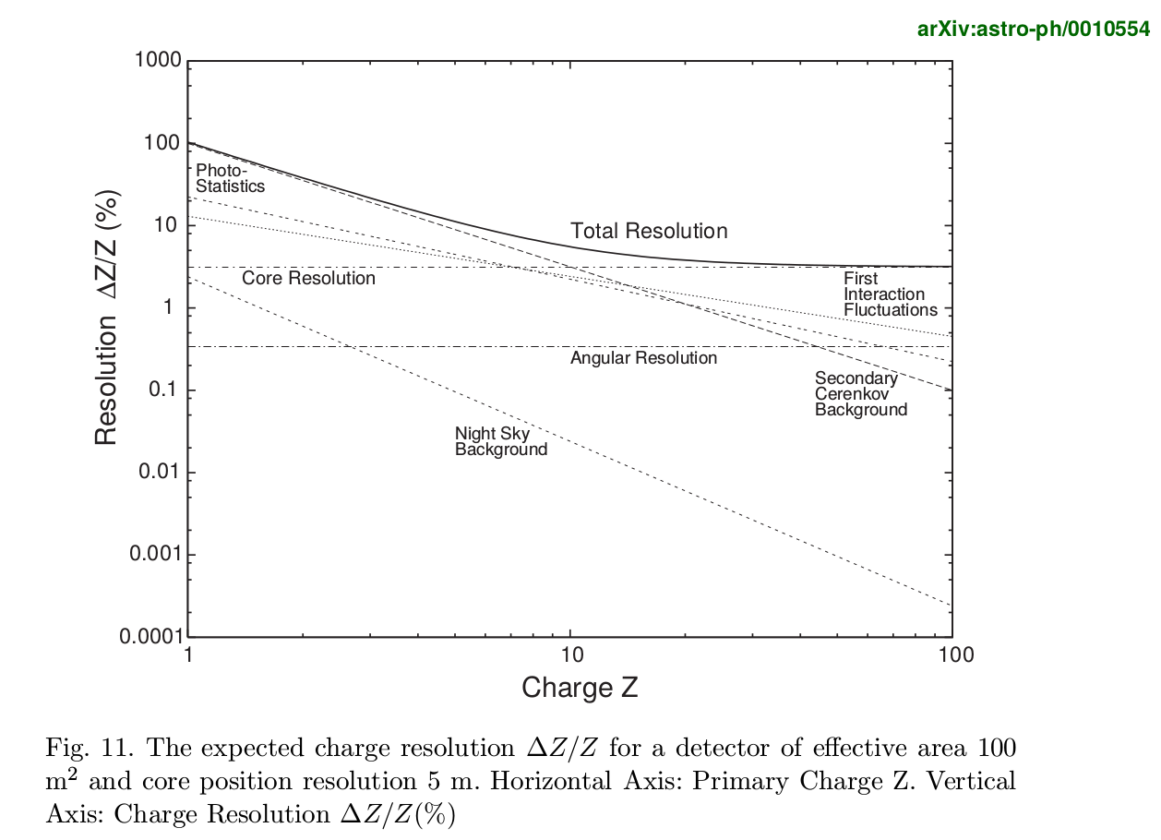

Slide 6
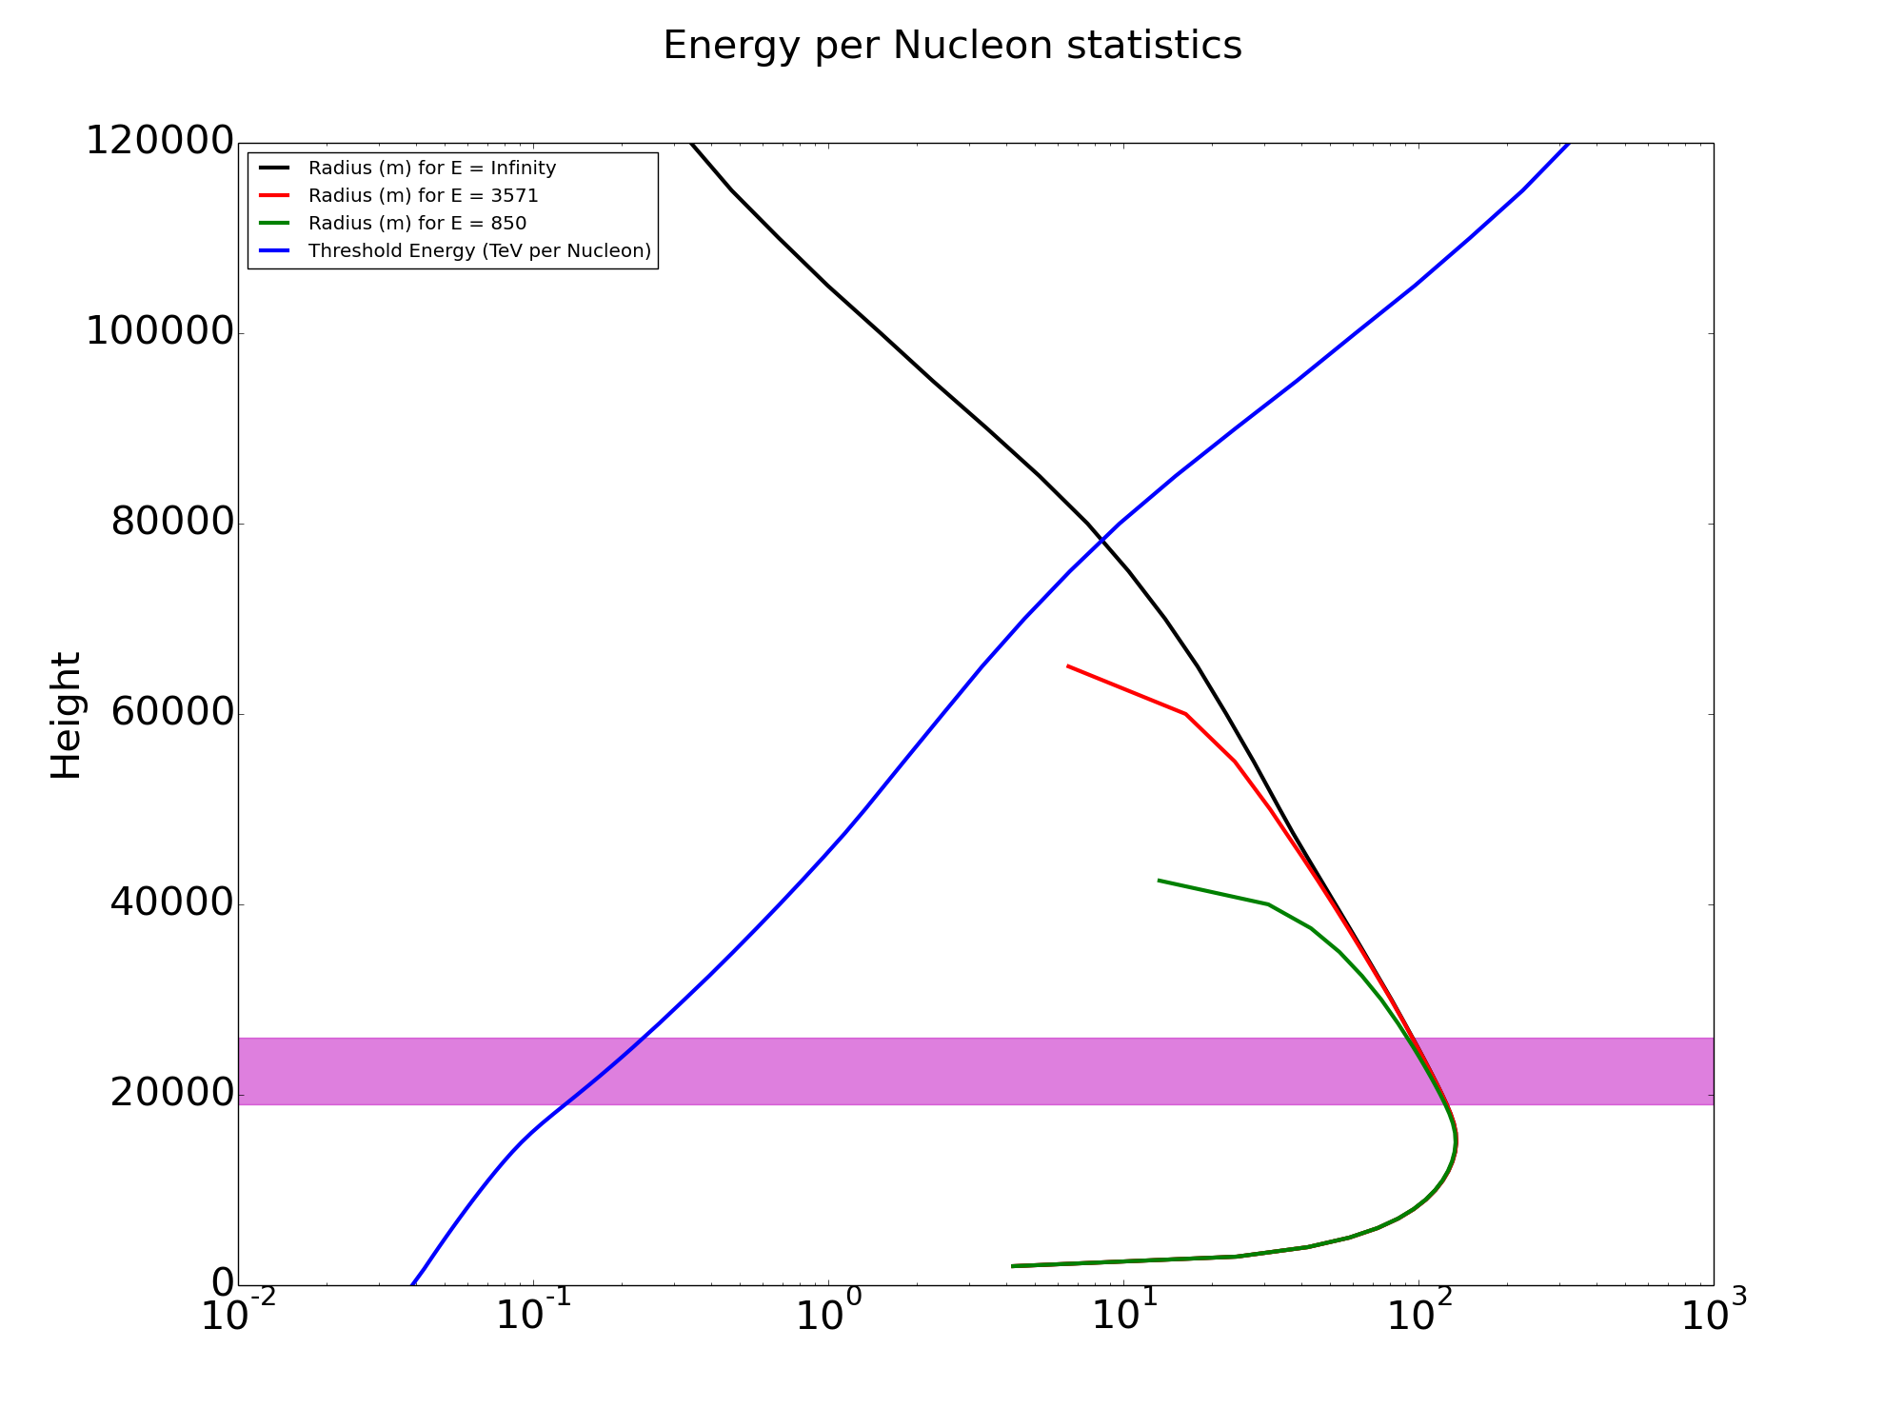

Slide 7
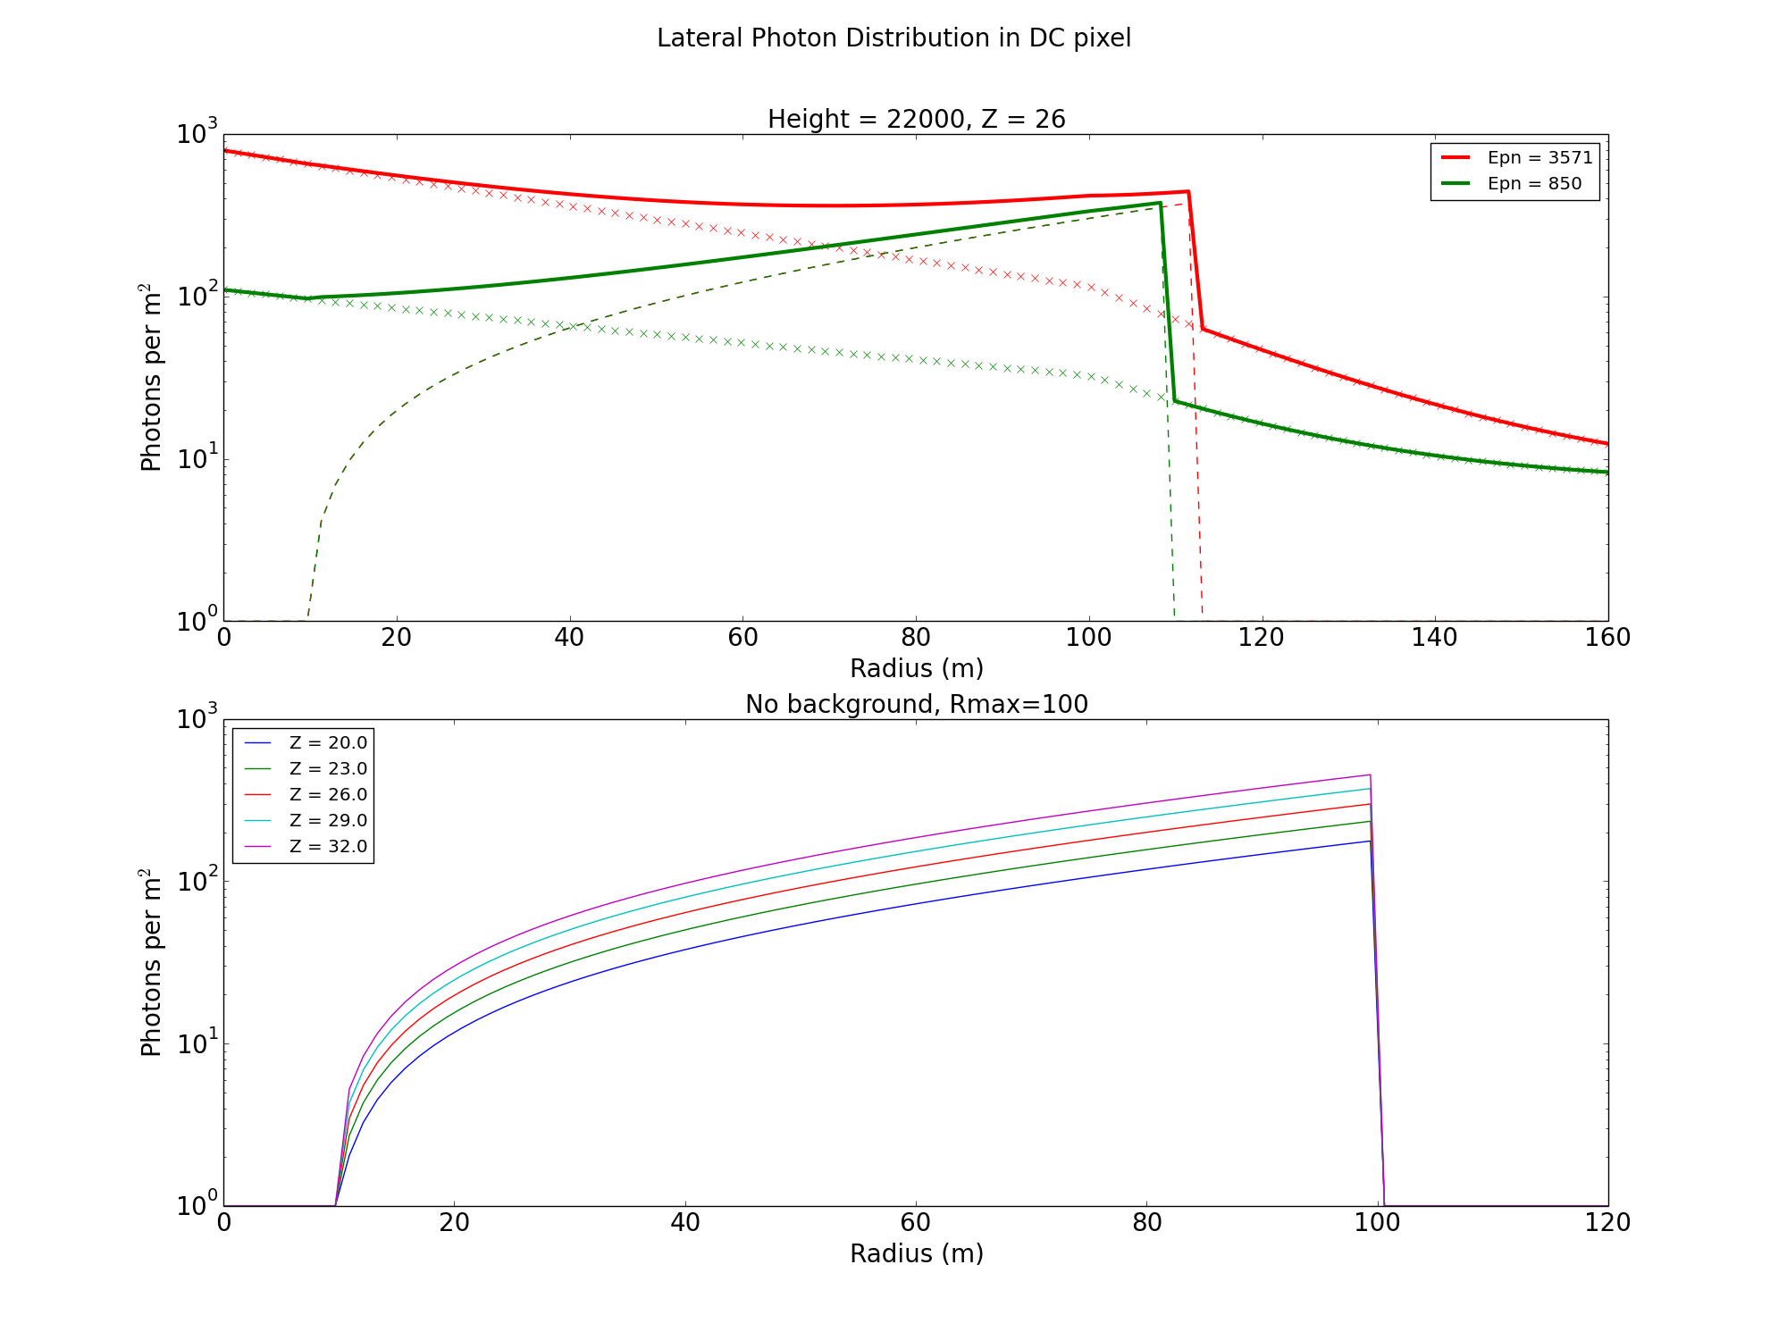

Slide 8
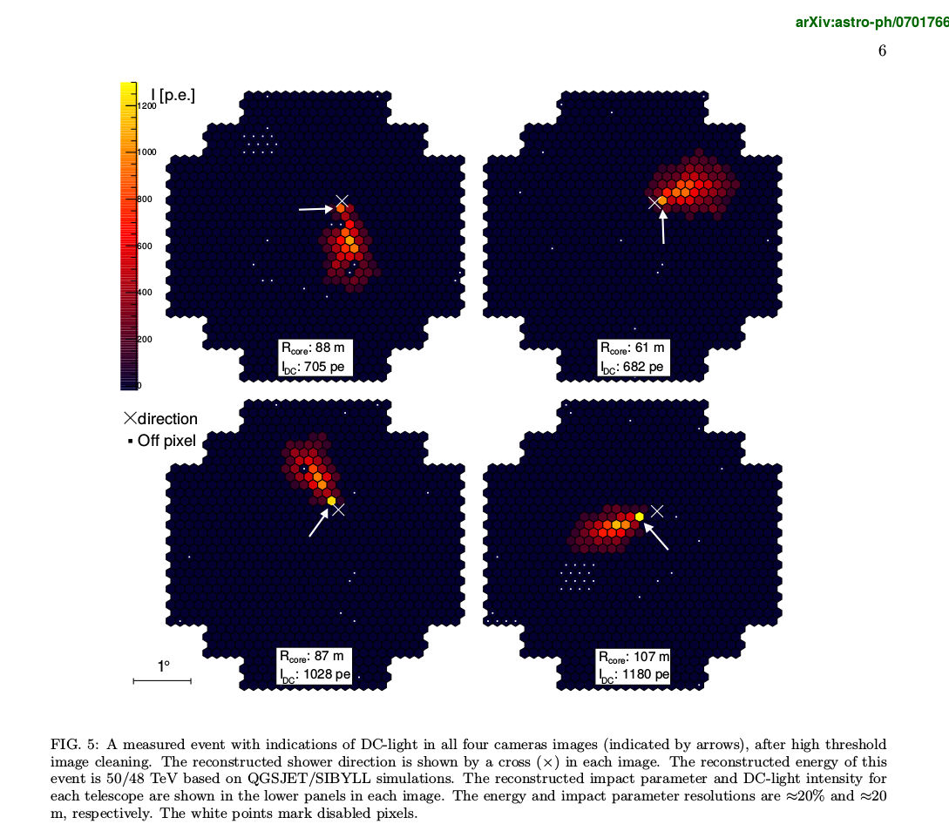

Slide 9
Fitting and event reconstruction
Five variables to reconstruct:
  x/y Core Position,
  First Interaction Height,
  Energy per Nucleon
  Charge.
+

Slide 10
Iterative Minimisation
Iterate over integer Z
Select a ~100m² region
Scan valid Height/Energy combinations
  13 Z values
  10 positions
  51 Epn/Height Combos
  13 x 10 x 51 = 6630
Candidate with smallest log likelihood of the 6630 runs is selected

Slide 11
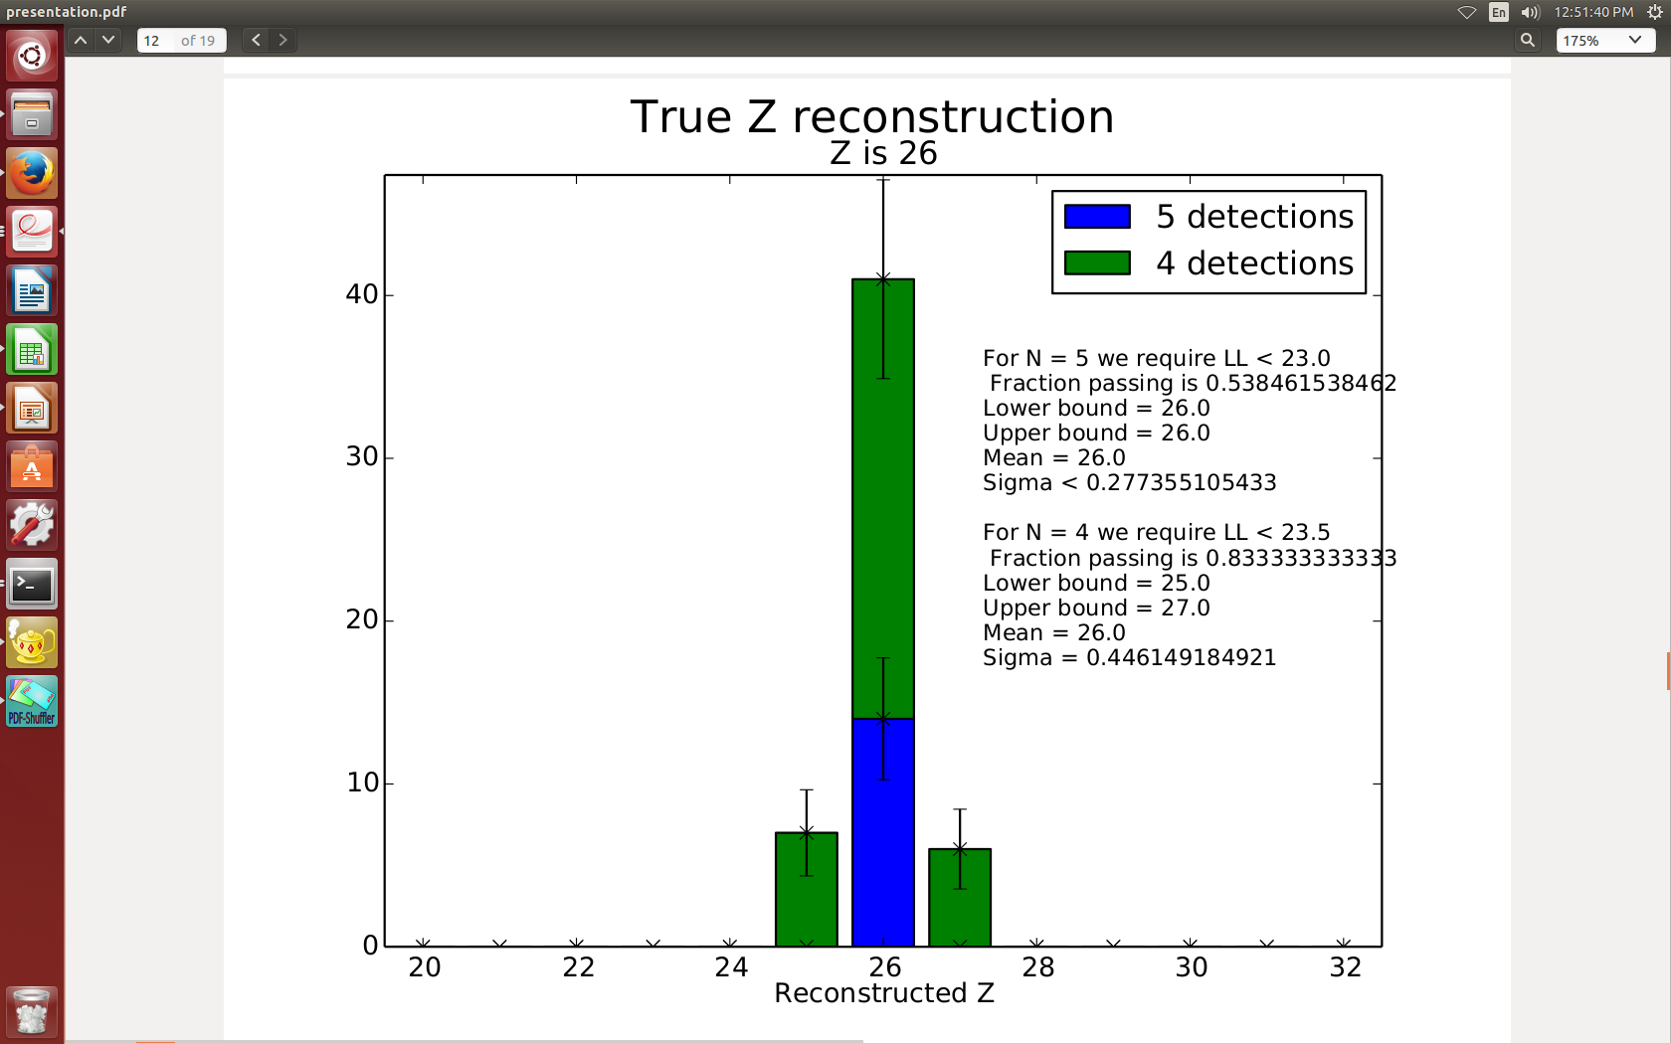

Slide 12
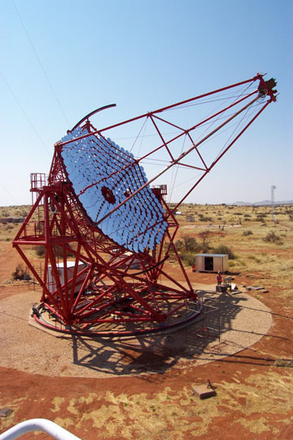
Optimised Telescope Array
Grid of 3 x 3 telescopes (variable grid width X)
Expected counts for 50 hours run time
Minimise σZ by balancing competing effects
X
X

Slide 13
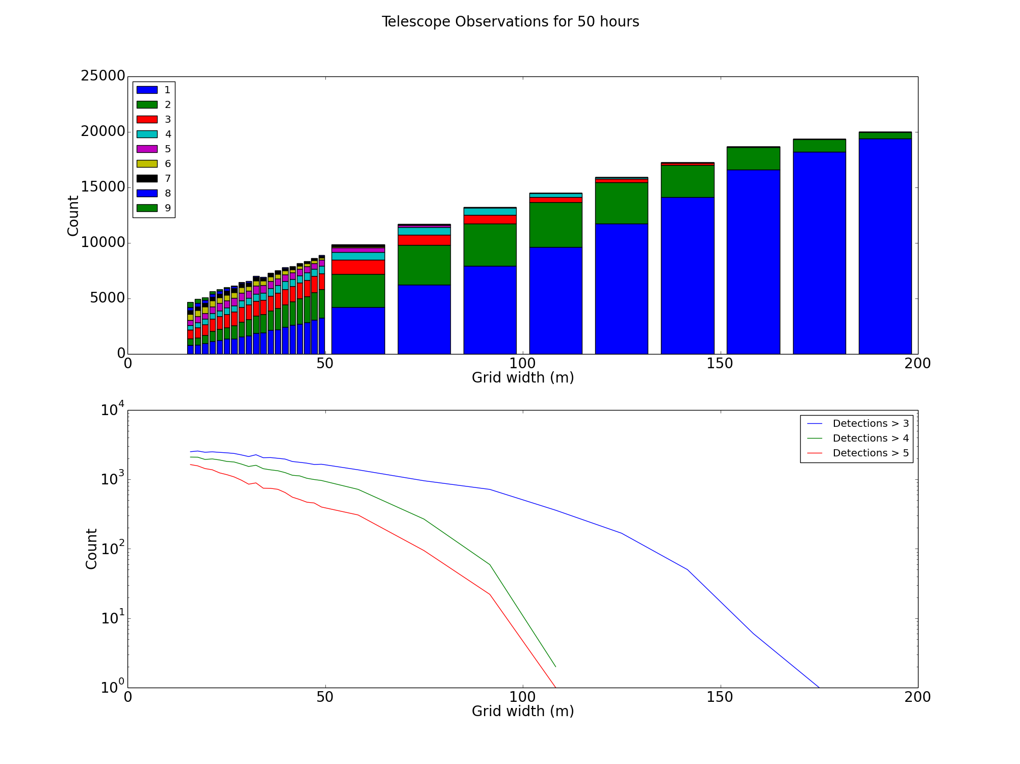

Slide 14
Summary
New Technique for Charge Reconstruction, valid for both current and future IACT systems.
Simulation with HESS-type layout yields a much improved core reconstruction.
Charge resolution of σZ < 0.3 for five telescope events.
Ideal future CT experiment would have 9 telescopes with a grid spacing of ~20-40m.
Consequent event rate would be ~15 events per hour observed by 5 or more telescopes.

Slide 15
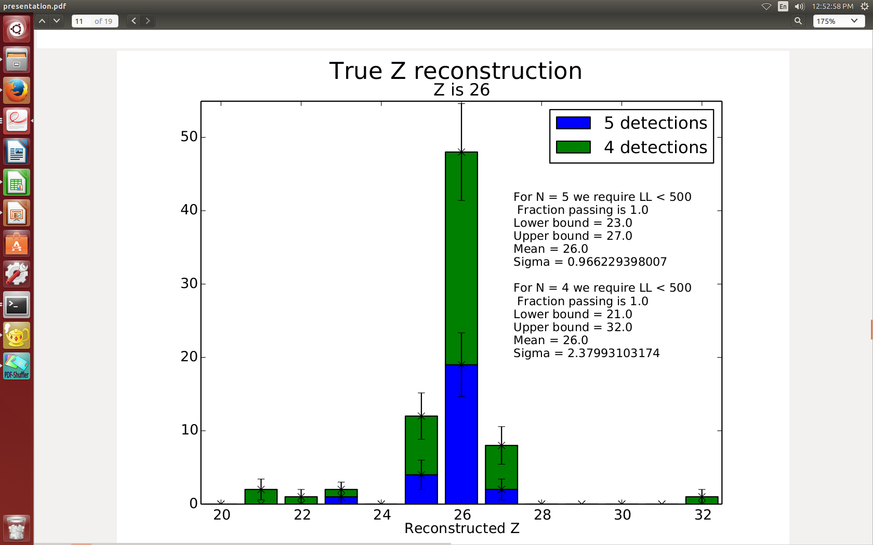

Slide 16
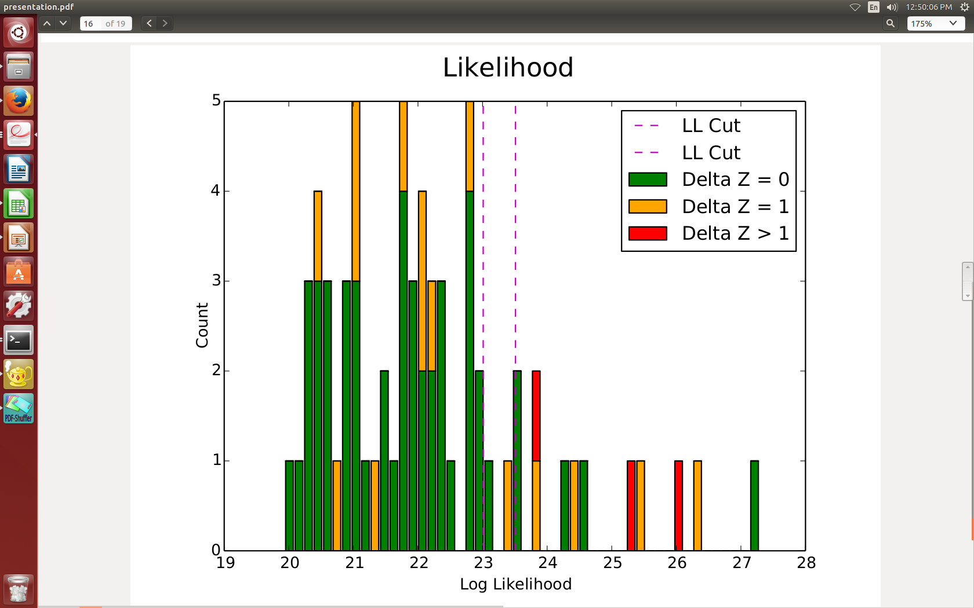

Slide 17
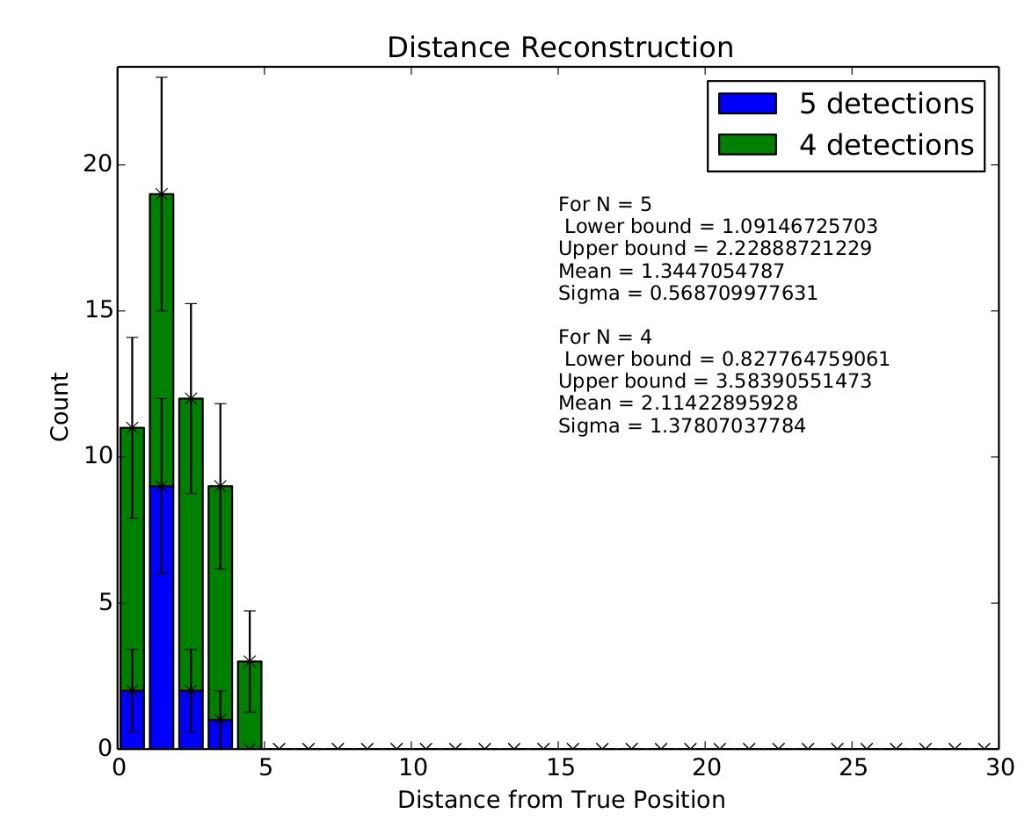

Slide 18
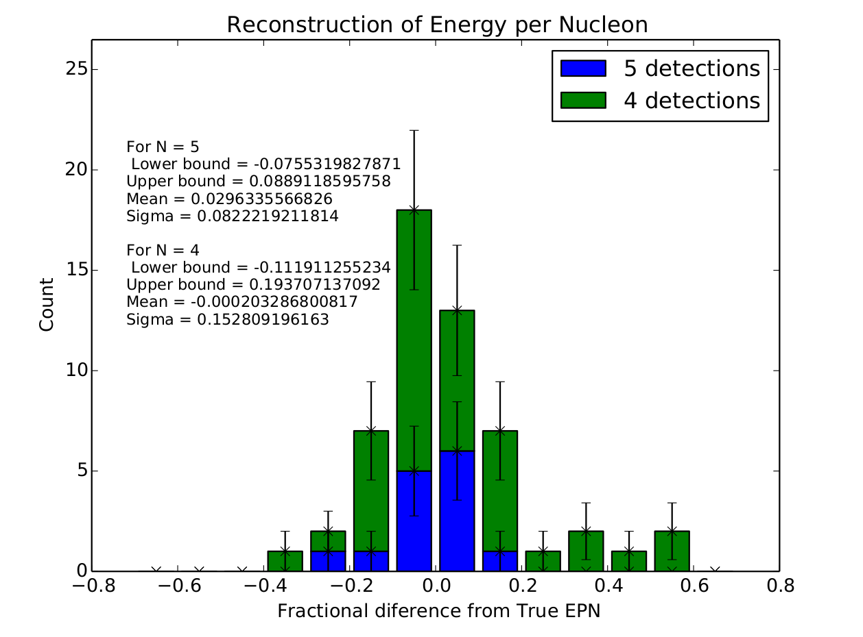

Slide 19
